Slide 1
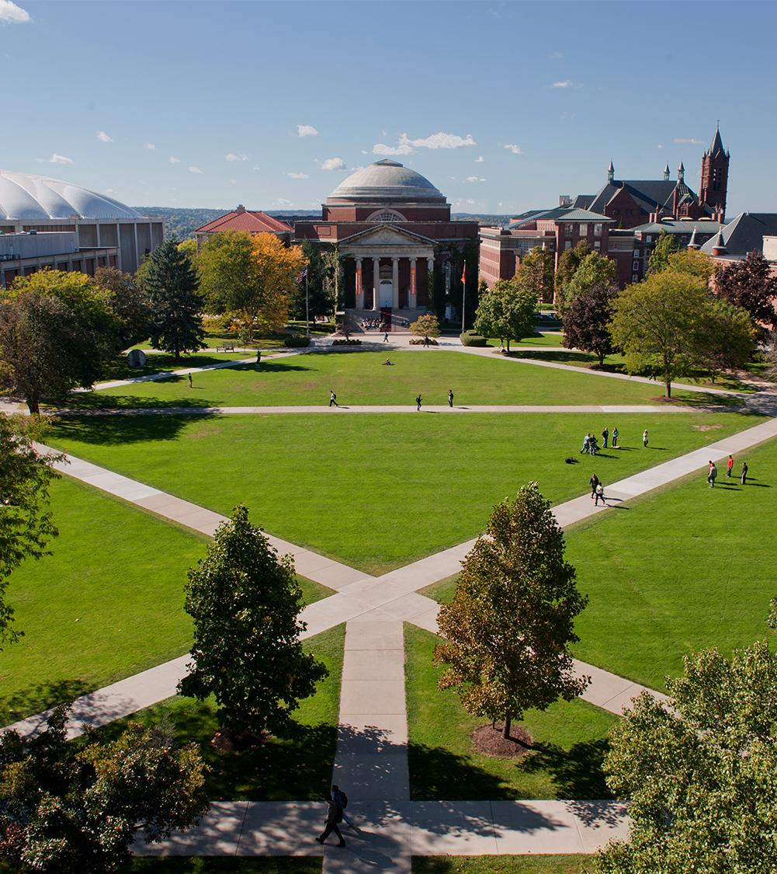
Comparison of Differing Machine Learning Algorithms dealing with Stock Market Prediction
Department of Electrical Engineering and Computer Science
Abi Parekh
Stephen O’Connor
Presentation Date

Slide 2
Introduction
Objective
Collect a historical Dataset for training and testing
Train a Convolutional Neural Network (CNN) and a Long Short-Term Memory (LSTM) model for comparison in performance
Obtain the metric reports for the evaluated models
What did you accomplish?
LSTM model outperforms CNN
LSTM: Max difference = 37.227, MSE = 114.01 (Tesla)
CNN: Max difference = 73.765, MSE = 227.568 (Tesla)
What actions do you need to complete?
Enhance the model for better performance in terms of stock prediction
Train Model using larger stock data set
Increase input parameters and features into CNN
Department of Electrical Engineering and Computer Science

Slide 3
Background/Previous Works
NYSE Stock Market Prediction Using Deep-Learning Models
4 different models
MLP, CNN, RNN, & LSTM
Paper states that CNN model outperformed
Tested on 5 stocks from the NYSE
Department of Electrical Engineering and Computer Science

Slide 4
Experimental Design

Slide 5
Overview of experiment design
Design Experiment
Using the same Data Set for training and validation are better results obtained from a CNN Model or an LSTM Model.
Predicting value of stock based on historical performance of the stock
Data Set
Huge Stock Market Data Set provided by the Kaggle Website.
Data Set provide the full historical daily price and volume data for all US-based stocks and ETFs trading on the NYSE, NASDAQ, and NYSE MKT.
Used Subset of Stocks related Automotive Manufacturing:
Ford, General Motors, Honda Motor Company, Toyota Motor Company, Navistar, Paccar, and Tesla
Chosen Stocks have unevenly distributed data points
Note: Data Set does ends in 2017 prior to the start of COVID-19 Pandemic
Department of Electrical Engineering and Computer Science

Slide 6
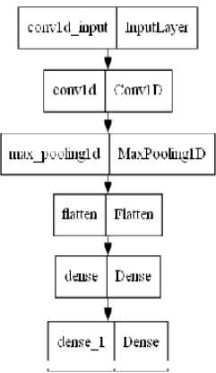
Convolutional Neural Network
The CNN Machine Learning Model is implemented as a Sequential Model using TensorFlow
Groups of Layers
Conv2D Layers: Applies a sliding convolutional filter to 1D input attempting to extract features
Flatting/Dense Layers: known as the fully connected layers, assist in mapping the representation between the inputs and the outputs.
Drop out: protects the model from overfitting to the training data
Department of Electrical Engineering and Computer Science

Slide 7
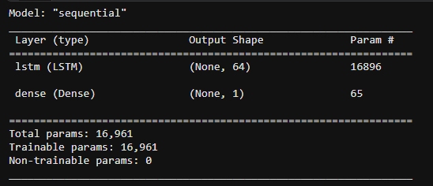
Long Short-Term Memory
The LSTM Model is implemented as a Sequential Model using TensorFlow
Groups of Layers
LSTM layer: It consists of 64 memory units. Processes the input, notes down temporal dependencies, and holds past values.
Dense Layer: Consists of 1 unit, processes the output. Produces the predicted stock price
Department of Electrical Engineering and Computer Science

Slide 8
Results & Conclusion

Slide 9
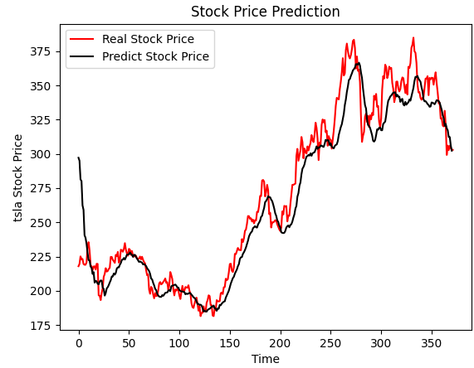
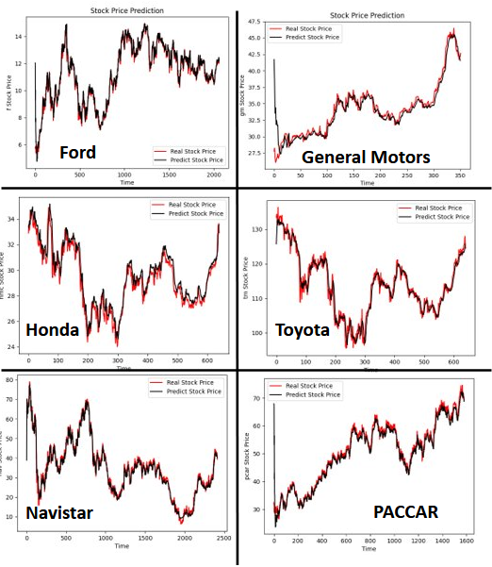
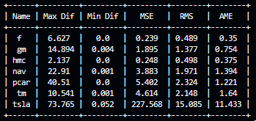
Convolutional Neural Network Results
Model performed differently on each stock (Over Valuing vs Under Valuing)
Performed extremely poorly with stocks with Large Variations week to week (PACCAR and Tesla)
Performed better with stocks that followed trends or were stable.
Department of Electrical Engineering and Computer Science

Slide 10
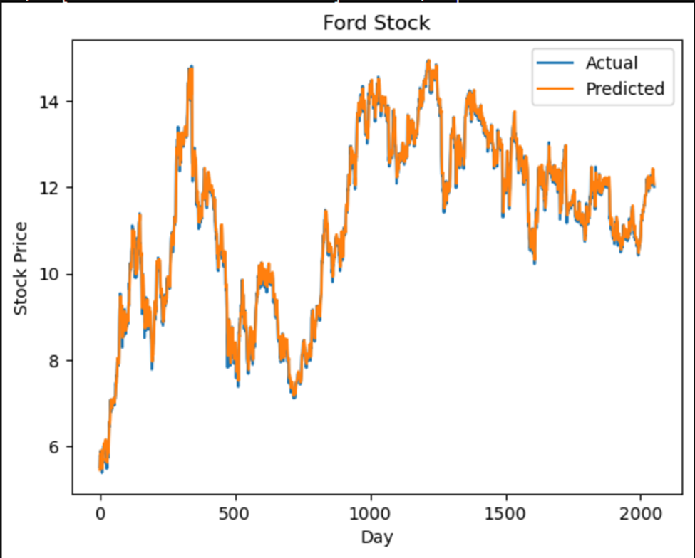
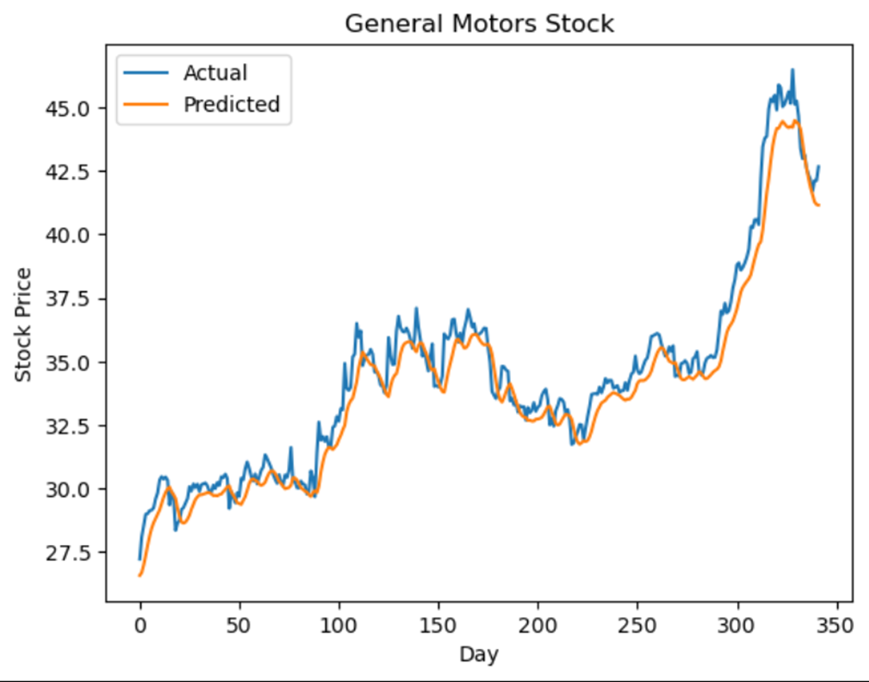
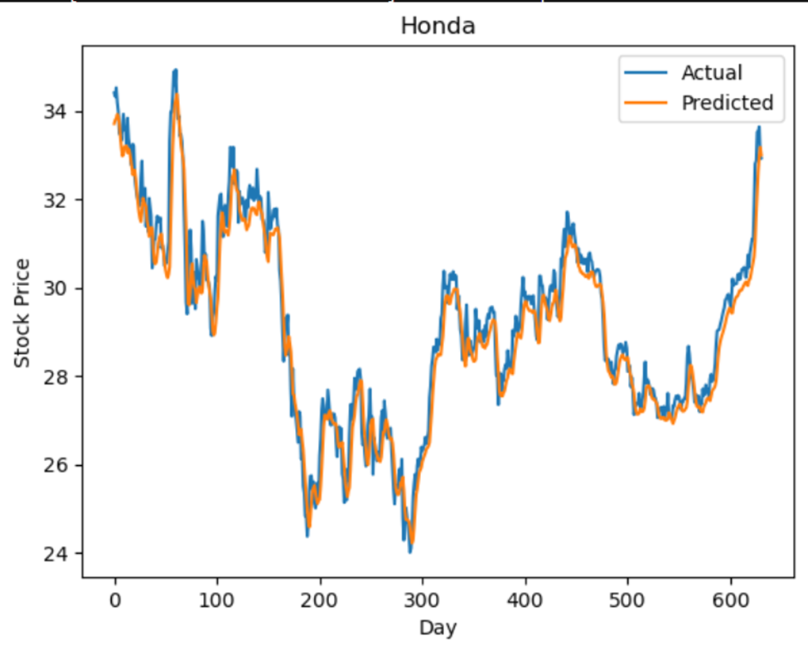
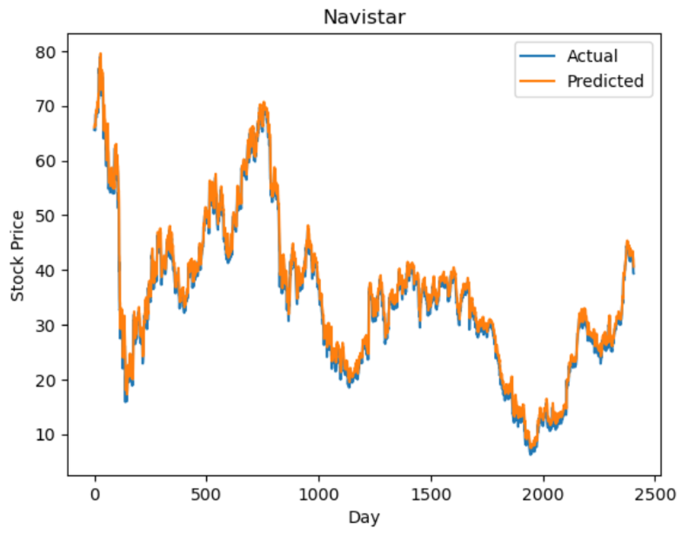
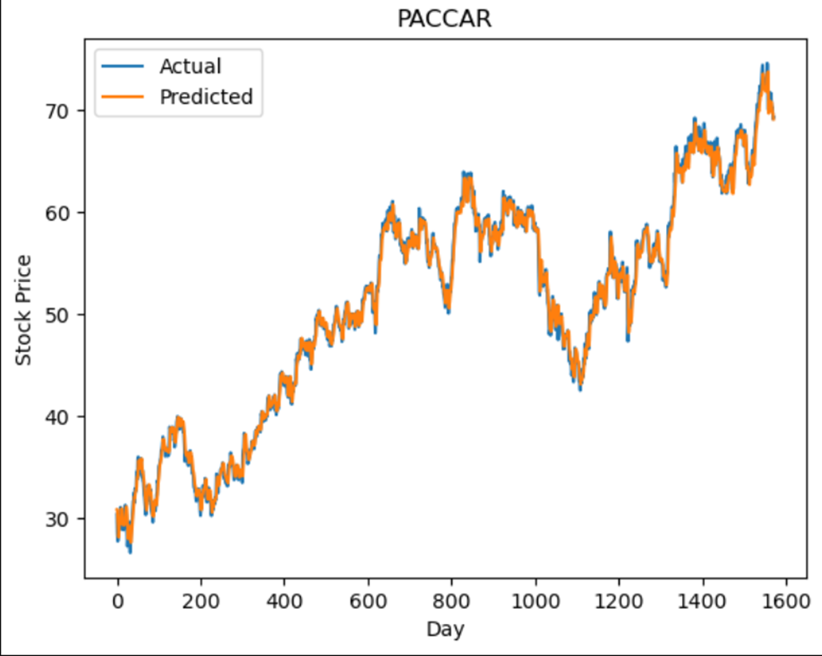
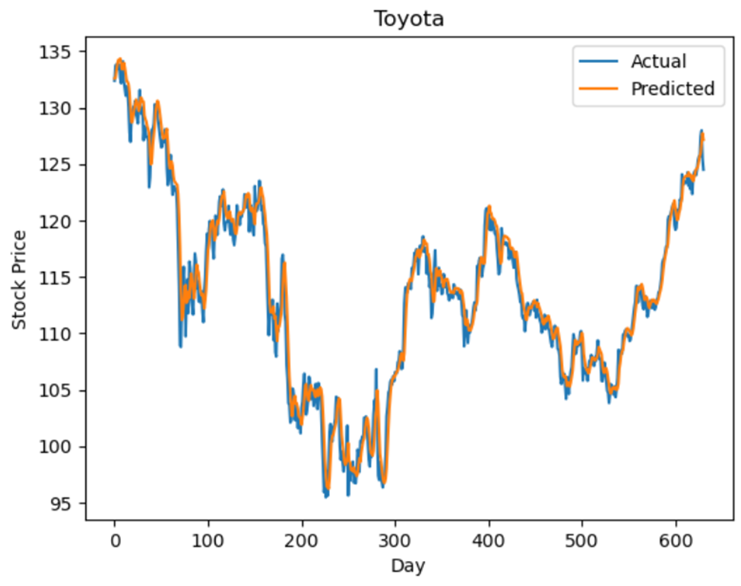
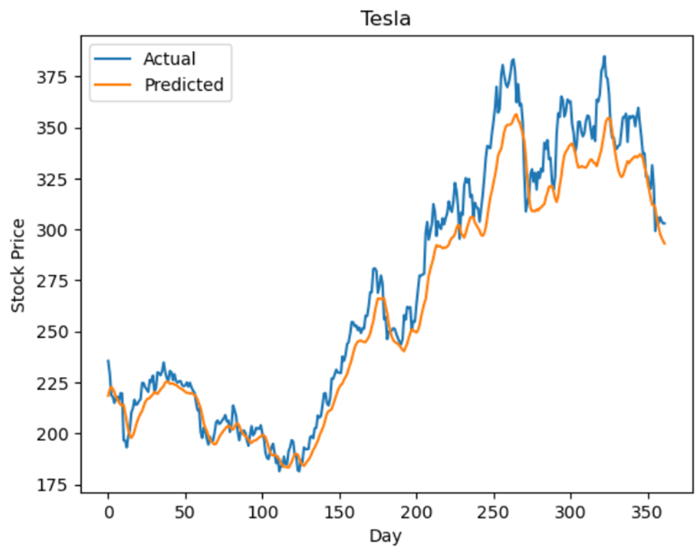
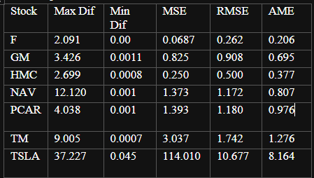
Performance of Long Short-Term Memory Model
Department of Electrical Engineering and Computer Science

Slide 11
Conclusion/Future Works
Conclusion:
LSTM performs the best for predicting stock prices
LSTM holds previous values for prediction
Less data points means a higher MSE
CNN finds it difficult handling noise in the data
Future Works:
Test with additional data sets
Tweak CNN and LSTM Models for better performance
Metric | CNN | LSTM
Max Difference | 73.765 | 37.227
MSE | 227.568 | 114.010
RMSE | 15.085 | 10.677
Model Training Time | 1-3 Seconds | 1 minutes 14 seconds
Execution Time | 1 Second | 8 Seconds
Metrics values are for Tesla
Department of Electrical Engineering and Computer Science

